Slide 1
Experiment-4

Slide 2
Steps to create container from Docker Hub

Slide 3


Prepared By
Bhuvnesh Sanathra
Semester-7

Slide 4
How to create container from Docker Hub?
Open browser and open Docker Hub after that search images what you have to download and make the container

Slide 5
How to create container from Docker Hub?
There are 2 options:
Pull image from Docker hub and then create container.
Direct use Docker run command to create container.

Slide 6
Steps to create container from Docker Hub?
To create container with container name and port
# docker run –it –name bhuvi –p 80:80 nginx:latest
Name of container
Port for outside access
Image name on docker hub

Slide 7
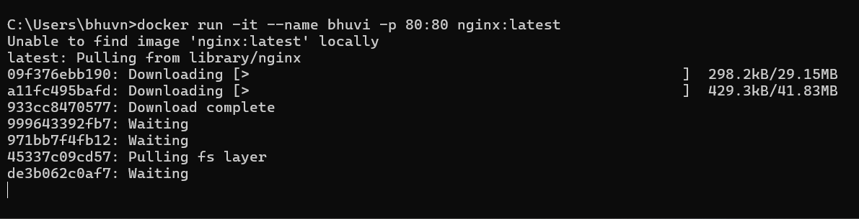
Steps to create container from Docker Hub?
To create container with container name and port

Slide 8
Steps to create container from Docker Hub?
Check that container is available or not
# docker ps -a

Slide 9
Steps to create container from Docker Hub?
To start container
# docker run bhuvi

Slide 10

Steps to create container from Docker Hub?
Create index.html file
# vi index.html

Slide 11
Steps to create container from Docker Hub?
Copy index.html and paste it in nginx directory
# docker cp index.html bhuvi:/usr/share/nginx/html/

Slide 12
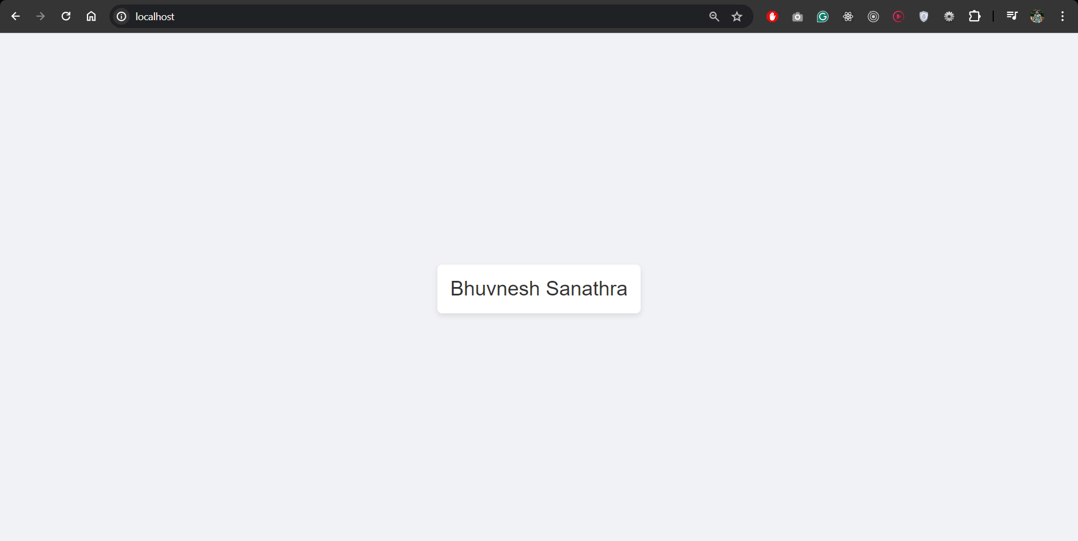
Steps to create container from Docker Hub?
Run in localhost on port 80
localhost:80

Slide 13
Thank You

